Slide 1
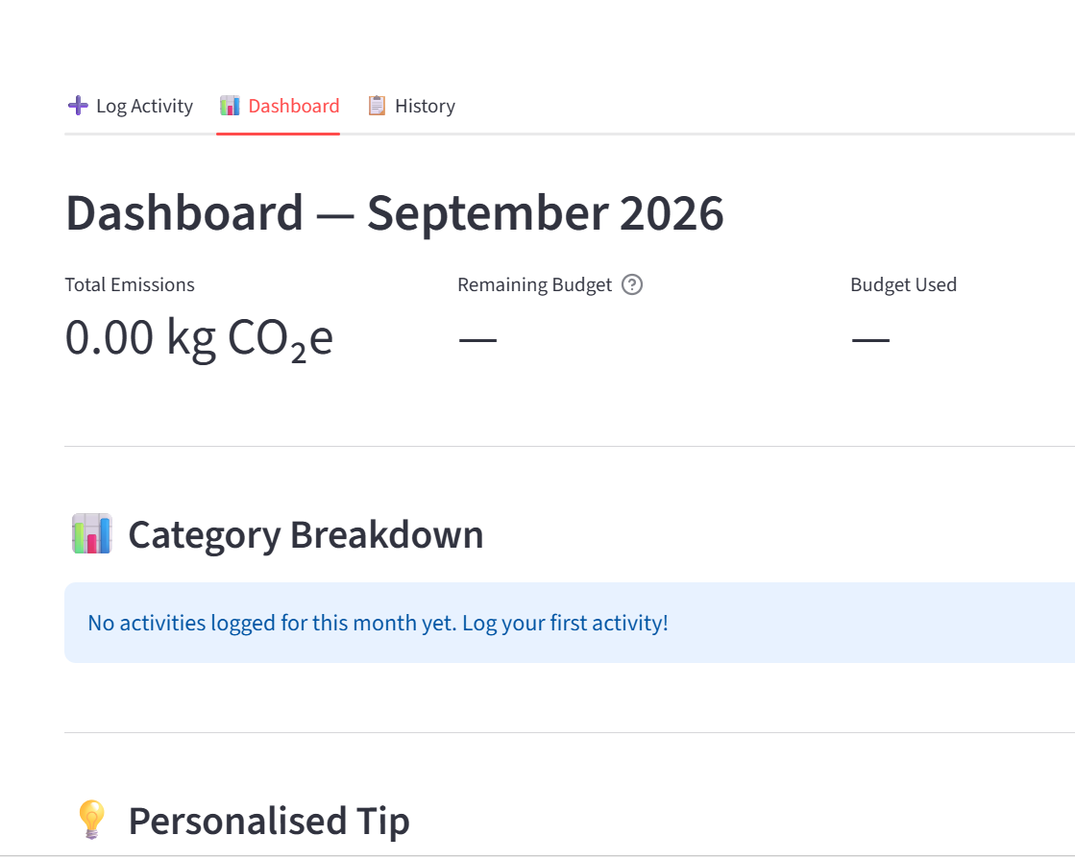
Eco Tracker
Product Walkthrough & Functional Exploration
A screen-by-screen analysis of the current Streamlit interface, user journey, data model, calculations, validation, and next-step architecture.
Based on supplied UI screenshots
Dashboard — September 2026
Core idea
Capture everyday activities → estimate CO₂e → compare against a monthly budget → learn from history.
Important: where behavior is not visible in the screenshots, this deck labels it as an inference or recommended implementation.

Slide 2
1. What the product is designed to do
The screenshots show a small personal carbon-tracking workflow centered on activities, monthly budgets, and history.
PRODUCT MAP
Capture activity
Understand impact
Control a budget
User records a date, activity type, category, amount in the displayed unit, and an optional description.
Dashboard summarizes total emissions and breaks results down by category.
A monthly CO₂e target can be set and then compared with actual usage.
Target user
Current evidence from UI
A person who wants a lightweight, repeatable way to understand the carbon impact of everyday activities without using a complex reporting system.
The app already exposes three main pages — Log Activity, Dashboard, and History — plus sidebar controls for viewing month and monthly budget.
Primary value loop: log → calculate → compare → review → change behavior

Slide 3
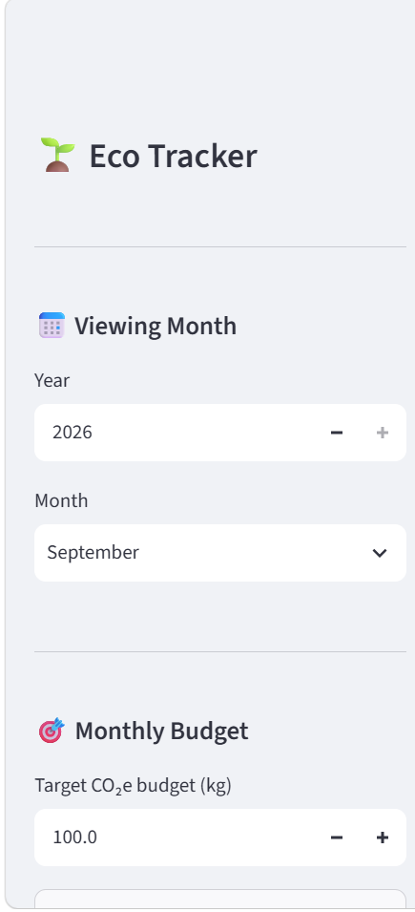
2. Application structure & navigation
The information architecture is intentionally small, which is good for a beginner-friendly Streamlit project.
NAVIGATION
Log Activity
Dashboard
History
Sidebar responsibility
Viewing Month and Monthly Budget affect what the main pages display. The sidebar therefore behaves like global app state.
Navigation responsibility
Page navigation is separate from the user’s month and budget controls, making the main journey easy to understand.
Sidebar controls shown in the screenshots
Inference: exact navigation implementation (tabs, pages, or session state) is not visible in the screenshots.

Slide 4
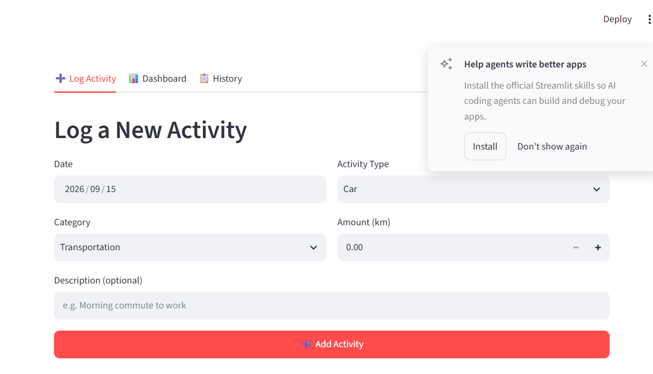
3. Log Activity — the main data-entry screen
This page is the source of the activity records used everywhere else in the app.
PAGE DEEP DIVE
Date
Default shows 2026/09/15. This identifies the month and reporting period for the activity.
Activity Type
Example shown: Car. This likely selects the activity/emission factor family.
Category
Example shown: Transportation. This powers category-based aggregation on the dashboard.
Amount (km)
The current example is distance-based, so the unit appears directly in the field label.
Description (optional)
Supplied screenshot
Free text such as “Morning commute to work” adds context without being required.
The screenshot supports the fields above. It does not show the complete list of activity types, categories, or emission factors.

Slide 5
4. Dashboard — turn activity into a monthly story
The dashboard is the interpretation layer: it converts individual logs into a compact monthly view.
PAGE DEEP DIVE
Total Emissions
Primary KPI. The screenshot shows 0.00 kg CO₂e when no activity is logged.
Remaining Budget
Shows what is left against the monthly target; the screenshot displays “—” when no budget is set.
Budget Used
Companion KPI for budget consumption. The screenshot also shows “—” before a budget is configured.
Category Breakdown
A visual/summary area intended to show how emissions are distributed across categories.
Personalised Tip
The UI includes a dedicated tip area for user-specific guidance.
Supplied dashboard screenshot

Slide 6
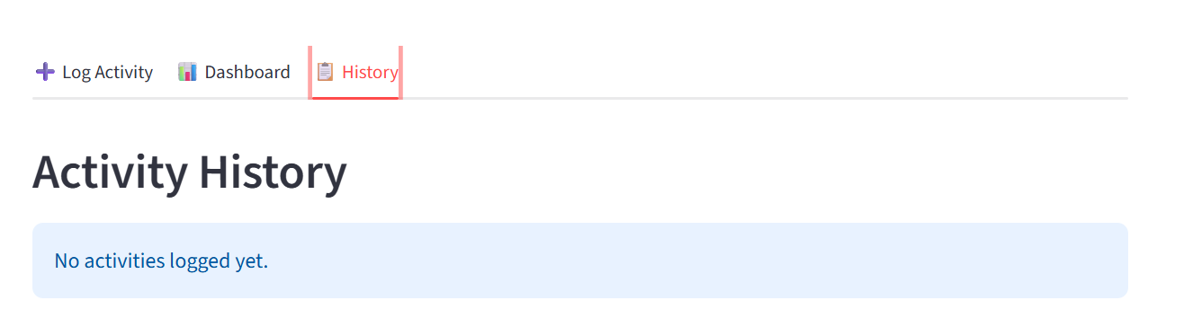
5. History — audit the activity log
History is the traceability layer. The supplied state shows the empty state before any activity has been logged.
PAGE DEEP DIVE
Current state
“No activities logged yet.” This is a correct empty-state message and prevents a blank page from feeling broken.
Expected purpose
Review what was entered, when it was entered, and how it contributed to the monthly picture.
Supplied history screenshot
Recommended columns
Recommended actions
Why it matters
Date • Activity • Category • Amount • CO₂e • Description
Edit • Delete • Filter by month/category • Sort by date
History makes the dashboard explainable: every aggregate should trace back to individual records.
Recommended history capabilities are not visible in the supplied screenshot; they are proposed product improvements.

Slide 7
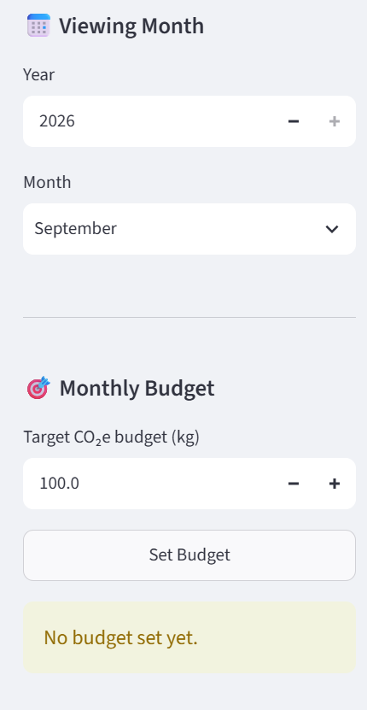
6. Sidebar settings — month selection & monthly budget
The sidebar controls the reporting context used across the application.
GLOBAL STATE
Viewing Month
Monthly Budget
Year selector + month selector. This controls which month the dashboard/history are focused on.
Target CO₂e budget in kilograms. Example shown: 100.0 kg.
Set Budget
Empty state
An explicit button indicates the user confirms the target rather than changing it silently.
“No budget set yet.” clearly communicates why budget KPIs are not populated.
Design principle: reporting context should be stable while the user moves between pages.
Supplied sidebar screenshot
The screenshots show the budget input and empty state, but not persistence behavior after “Set Budget”.

Slide 8
7. End-to-end user journey
A good demo should follow the same mental model a real user would use.
WORKFLOW
1
2
3
4
5
Choose month
Set budget
Log activity
View dashboard
Review history
Select year + month in the sidebar.
Enter a monthly CO₂e target and confirm it.
Enter date, activity type, category, amount, and optional description.
See total emissions, budget status, category breakdown, and tips.
Audit the individual entries that produced the monthly totals.
Best demo moment: after adding one activity, return to Dashboard and show the KPI/category changes.

Slide 9
8. Data model behind the screens
This is a recommended conceptual model inferred from the fields visible in the UI.
RECOMMENDED MODEL
Activity record
Monthly budget
App/reporting state
activity_id
date
activity_type
category
amount
unit
description
co2e_kg
created_at
budget_id
year
month
target_co2e_kg
set_at
selected_year
selected_month
active_page
selected budget
user preferences (optional)
Key relationship
Activities belong to a reporting month; the dashboard aggregates their CO₂e values and compares the total with the month’s target budget.
This model is a design proposal. The screenshots do not reveal the actual storage schema.

Slide 10
9. Emissions calculation logic
The screens expose the inputs and outputs, but not the calculation formula. The following is the standard implementation pattern recommended for this product.
CALCULATION
Activity amount × emission factor = estimated CO₂e
Input 1 — amount
Input 2 — factor
Output — CO₂e
Example from UI: 12.5 km driven.
Factor should come from a maintained activity/emission-factor table.
Store the calculated kg CO₂e on the activity record so history remains auditable.
Example (illustrative only)
If a selected activity had a factor of 0.17 kg CO₂e/km, then 12.5 km × 0.17 = 2.125 kg CO₂e. The factor is only an example here — it is not shown in the screenshots.
Recommended implementation: keep factors in data, not hard-coded into page widgets, so factors can be updated without rewriting the UI.

Slide 11
10. Validation & edge cases the app should handle
These rules make the dashboard trustworthy rather than merely functional.
QUALITY CHECK
Input validation
Budget validation
Consistency checks
Date must be valid; amount should be numeric and non-negative; required selectors must have a value; descriptions should be trimmed.
Target budget should be numeric and greater than zero before “Set Budget” succeeds.
Activity type, category, and unit should match an allowed combination. Example: a distance-based record should not silently accept a weight unit.
Empty & boundary states
Error handling
No activities • no budget • first activity • very large amount • month with zero activity • switching months with no data.
Show a clear inline message, do not save invalid records, preserve valid inputs when possible, and avoid a broken dashboard state.
Trust rule: every number on the dashboard should be reproducible from saved activity records + the selected budget.

Slide 12
11. UX assessment — what is already strong, and what to improve
The screenshots suggest a simple, clean beginner project with a clear path from entry to reporting.
UX REVIEW
Strengths
Improve next
Make it more explanatory
• Clear three-page structure
• Strong empty-state messages
• Monthly reporting context is visible
• Budget is separated from activity entry
• Dashboard puts the key KPI first
• Make units dynamic by activity type
• Show saved/updated confirmation
• Add edit/delete to history
• Expose exact CO₂e for each activity
• Add budget progress % / visual meter
• Add a small “How calculated?” help link
• Show the factor/source behind each estimate
• Explain why budget is “—”
• Make category colors/labels consistent
• Add a first-use onboarding hint
The strongest next upgrade is explainability: users should understand not only the number, but where the number came from.

Slide 13
12. Recommended technical architecture for a beginner Streamlit build
A small layered design keeps the project easy to learn and easy to extend.
ARCHITECTURE
Streamlit UI
pages, sidebar, forms, charts
Why this structure works
Pages stay focused on presentation. Business rules stay testable. Storage can change later without redesigning the UI.
Application services
log activity, set budget, query month, build dashboard
Carbon calculator
validate activity → select factor → calculate kg CO₂e
Suggested first milestone
Data layer
SQLite or CSV for a small single-user project
Make one complete path work end-to-end: set budget → log one car trip → calculate CO₂e → show dashboard KPI → show history row.
Reference data
activity types, categories, units, emission factors
Recommended architecture only; the screenshots do not expose the codebase or storage technology.

Slide 14
13. Presentation / demo script
Use this 2–3 minute sequence to explain the project clearly to a teacher, reviewer, or client.
DEMO SCRIPT
Introduce the problem
“Eco Tracker turns everyday activities into an easy monthly carbon picture.”
0:00–0:20
0:20–0:55
Show sidebar
Choose September 2026, explain the reporting month, then show the monthly budget concept.
0:55–1:30
Log an activity
Enter a car trip: date, activity type, transportation category, distance, and a short description.
1:30–2:05
Open Dashboard
Point to Total Emissions, Remaining Budget, Budget Used, Category Breakdown, and the personalised tip.
2:05–2:30
Open History
Explain that the dashboard is a summary, while History is the audit trail for individual records.
2:30–3:00
Close with architecture
Mention the calculation engine, stored activity records, monthly budget, and future enhancements.

Slide 15
Eco Tracker at a glance
A compact product with a clear core loop — ready to become a stronger carbon-awareness tool.
1
Capture
Activity records with date, type, category, amount, description
2
Calculate
CO₂e from an activity amount and an emission factor
3
Compare
Monthly target vs. actual emissions
4
Explain
Dashboard categories + history + personalised guidance
5
Improve
Validation, edit/delete, factor transparency, better progress visuals
Recommended next build: make the first complete happy path fully functional, then add history actions and explainability.
End of walkthrough. The deck distinguishes screenshot-supported observations from recommended design details.

